Slide 1
Low-Fi Prototype
Trina Sarkar, Alex Gill, Katy Shi, Ana Carolina Mexia
Notes:
Hello everyone my name is ana carolina mexia and today I will be presenting our team’s lo fi prototype. Once again the members of my team are Trina, Alex, Katy and Me.

Slide 2
Overview
Mission Statement
Sketch Prototype
Selected interface
Low-fi prototype
Task Flows
Method
Results
UI Changes
Notes:
In order to share the work we did the past week I will first walk you through the mission statement that arose from the problem we discovered in our needfinding. Then talk about the ideas we had to develop our app on different mediums and how we decided which Low-Fi prototype to test. Finally I will explain the general flow of our protype, how we tested it and what we learned from these tests.

Slide 3
Problem & Solution
Many new voters find the ballot and the issues proposed by their local government very hard to navigate. Our app mocks up a ballot such that you can click on individual issues/candidates and learn more about each one. The app is designed such that you could use it in line while waiting to vote and be sufficiently informed by the time you vote.
Notes:
After all our needfinding we decided that our main problem is how hard the ballot is to navigate and our solution is to have an interactive ballot that offers a quick and intuitive way to understand the ballot.

Slide 4

BallotBox
Know your vote
Notes:
For that we created ballot box, the app that will help you know your vote.

Slide 5
SKETCH OVERVIEW
IPHONE
IPAD#1
IPAD#2
Notes:
We experimented with three different concepts, one for iphone and two for ipad. The fundamental difference between the two ipad ones was that in one the entire ballot was displayed in half the screen and the details in the other half. While in the other we had different screens.

Slide 6
IPAD #1
Show ballot exactly as it looks on paper
Notes:
We ultimately chose the iPad app with different screens. because it best accomplishes our tasks. We want to show users the ballot as they would see it, which only works as an iPad app. iPad apps are also less cluttered, which makes it more user friendly and easier on the eyes. It is also easier to switch views from portrait to landscape, while still fitting the same amount of informatio

Slide 7
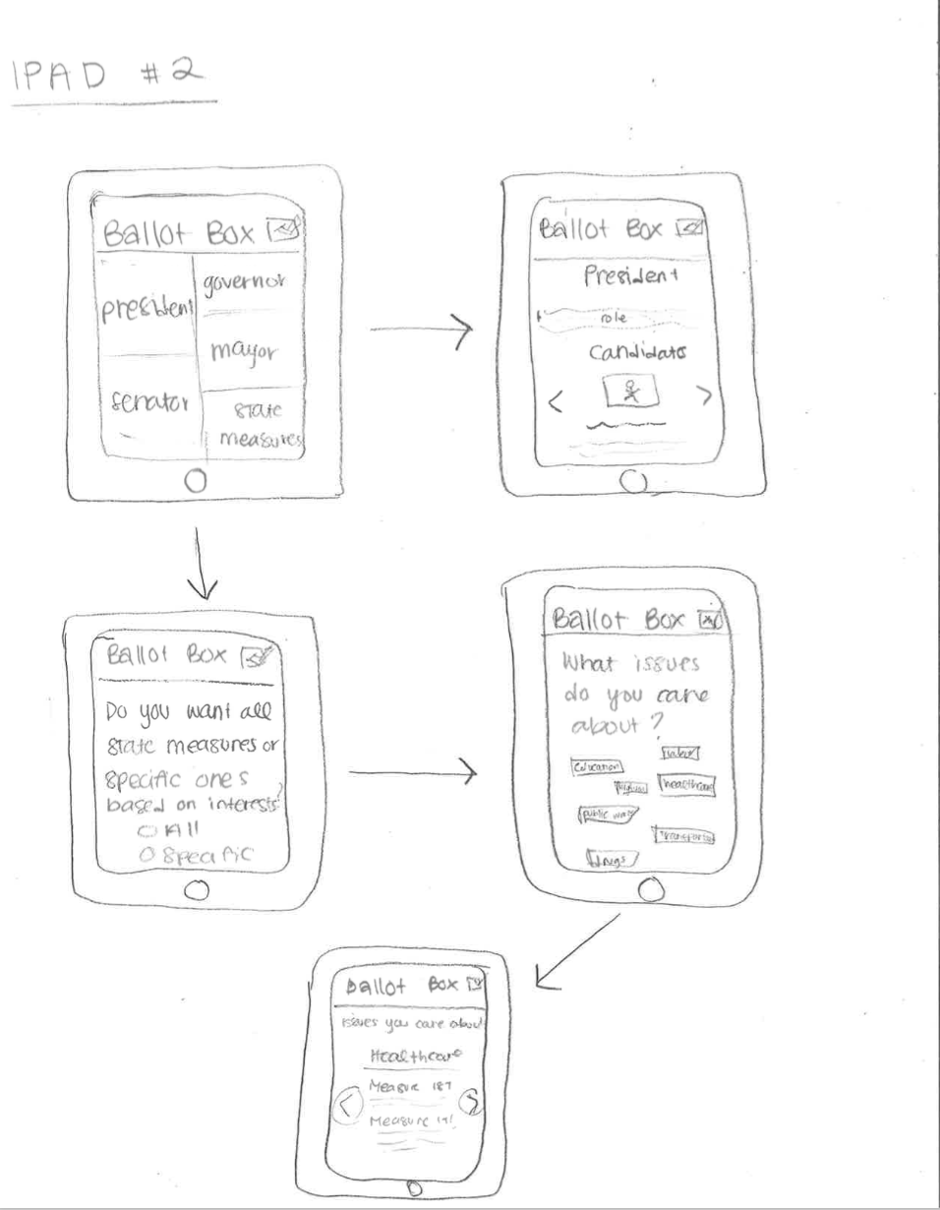
OVERVIEW
Notes:
The general idea of the app is that you have the ballot with the different sections clearly stated so that you can click on them. If you click in a section for a candidate it takes you to a screen displaying a candidate and with options to swipe to see the other candidates. If you click on the State measures you get the option of seeing all the the measures or getting one targeted to you.

Slide 8
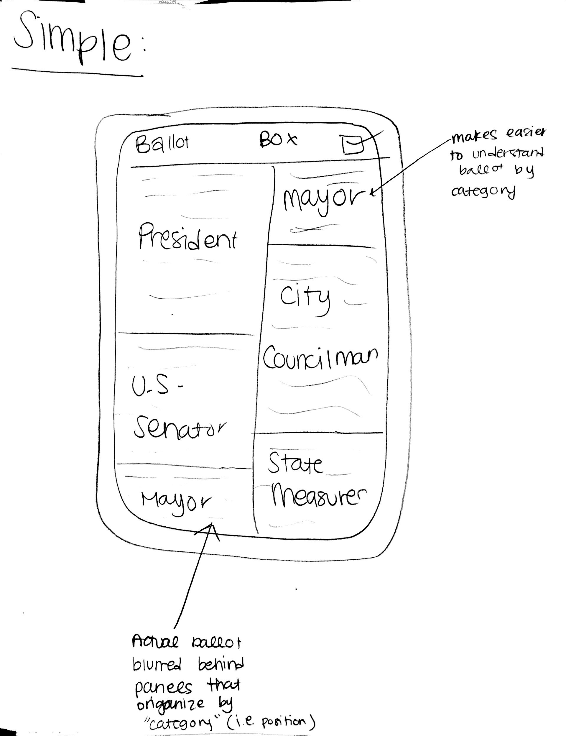
Task 1: Acquaint users with ballot
Categories in
Ballot Highlighted
Notes:
Our first task is to acquaint the user with the ballot and we decided to do this by making the ballot easier to navigate by dividing it into the main categories

Slide 9
Task 1: Acquaint users with ballot
Categories in
Ballot Highlighted
Actual Ballot Blurred as background
Notes:
We really wanted to have the actual ballo blurred in the background of the screen so that people can compare what they have in their hands with what they see on the screen .

Slide 10
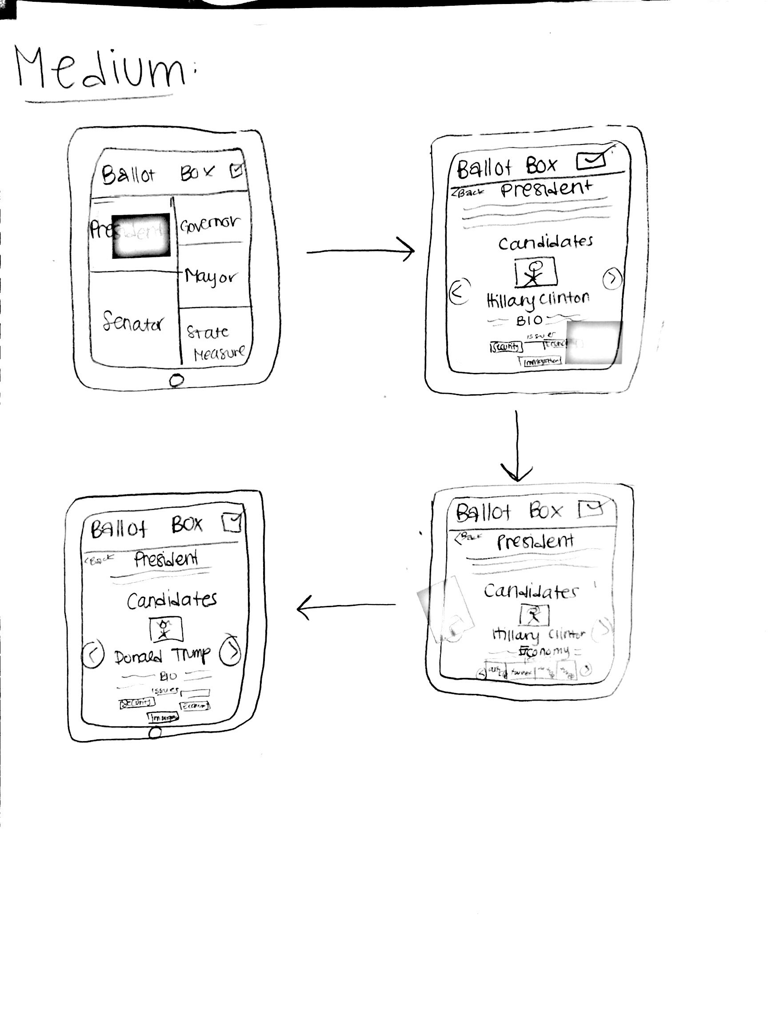
Task 2: Learn More about a specific candidate
Click on a category of the ballot
Notes:
Our next task is to give the user the ability to learn more about the different candidates they see on their ballot, with a short blurb and the option to link to more articles about the candidate.

Slide 11
Task 2: Learn More about a specific candidate
Click on a category of the ballot
Get short information about the candidate
Notes:
By clicking on it, get info about candidates

Slide 12
Task 2: Learn More about a specific candidate
Click on a category of the ballot
Get short information about the candidate or measure
Link to external Sources

Slide 13
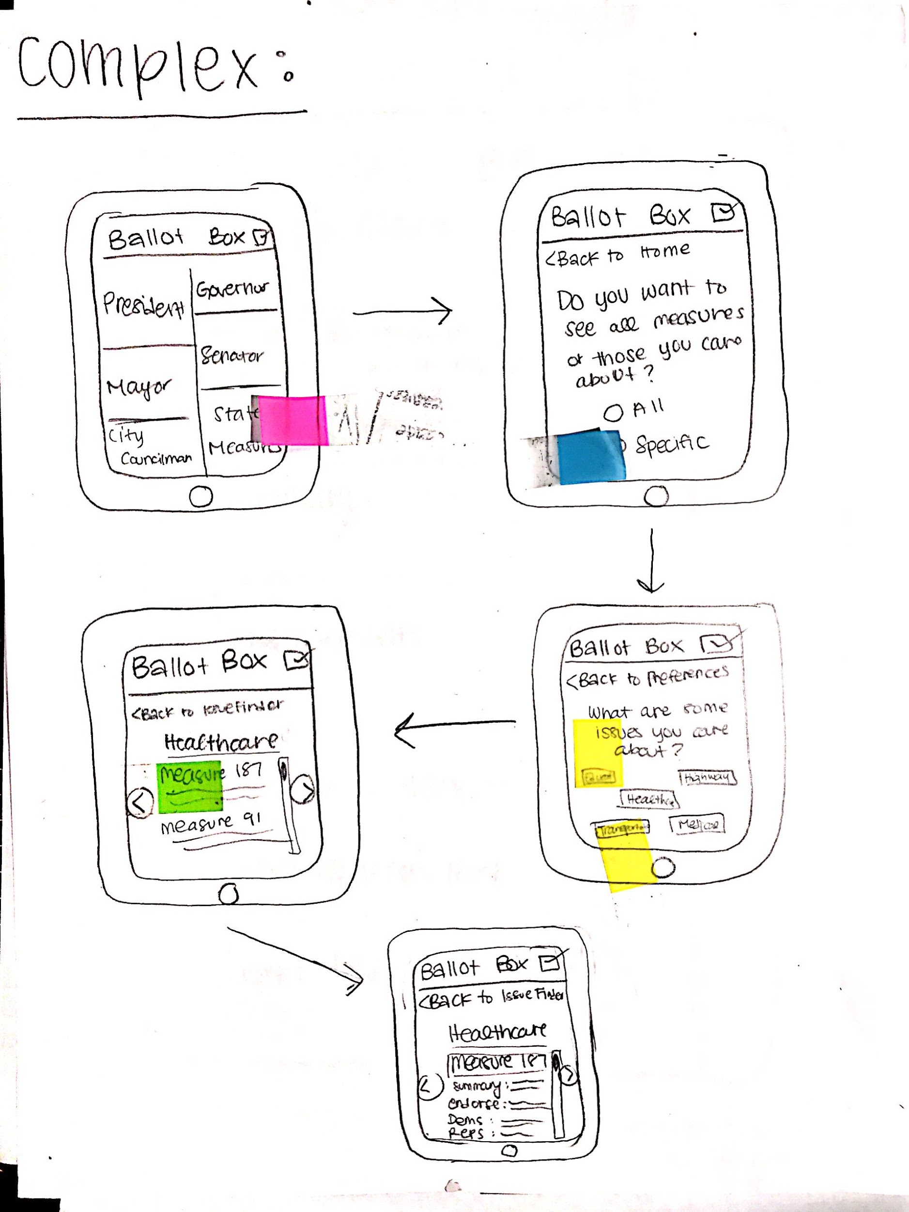
Task 3: Highlight Relevant Measures
Click on State measures on the ballot
Notes:
Our complex task is highlighting the measure on the ballot that are most relevant ot the user.

Slide 14
Task 3: Highlight Relevant Measures
Click on State measures on the ballot
Decide if you want to see all measures or specific ones

Slide 15
Task 3: Highlight Relevant Measures
Click on State measures o the ballot
Decide if you want to see all measures or specific ones
Select Topics of interest

Slide 16
Task 3: Highlight Relevant Measures
Click on State measures of the ballot
Decide if you want to see all measures or specific ones
Select Topics of interest
Get Relevant Measures

Slide 17
Method Participants & Locations
Participant 1
Male
50 years Old
Chef
Experienced Voter
House where he cooks
Notes:
We wanted to get 3 users with different Levels of expertise with the ballot in order to see what kinds of things different people are looking for. So we ended up testing it with two people from our target audience( new voters) and one more experienced voter.

Slide 18
Method Participants & Locations
Participant 1
Male
50 years Old
Chef
Participant 2
Female
20 Years old
Student Menlo College
Experienced Voter
New
Voter
House where he cooks
College Dorm
Notes:
We wanted to get 3 users with different Levels of expertise with the ballot in order to see what kinds of things different people are looking for. So we ended up testing it with two people from our target audience( new voters) and one more experienced voter.

Slide 19
Method Participants & Locations
Participant 1
Male
50 years Old
Chef
Participant 2
Female
20 Years old
Student Menlo College
Participant 3
Male
21 Year old
Student Stanford University
Experienced Voter
New
Voter
New
Voter
House where he cooks
College Dorm
College Dorm
Notes:
We wanted to get 3 users with different Levels of expertise with the ballot in order to see what kinds of things different people are looking for. So we ended up testing it with two people from our target audience( new voters) and one more experienced voter.

Slide 20
Method Details
Environment → We interviewed people in an environment they felt comfortable in to make it seem as natural as possible.
Notes:
Tested on an environment that these people felt comfortable

Slide 21
Method Details
Environment → We interviewed people in an environment they felt comfortable in to make it seem as natural as possible.
Procedure→
Alex @ Beggining: Explained app to users using script
Katy: Handed corresponding screen when they clicked
Trina: Observed and noted how users behaved
Caro: Noted relevant things users said
Alex @End: Asked for general feedback/ feelings

Slide 22
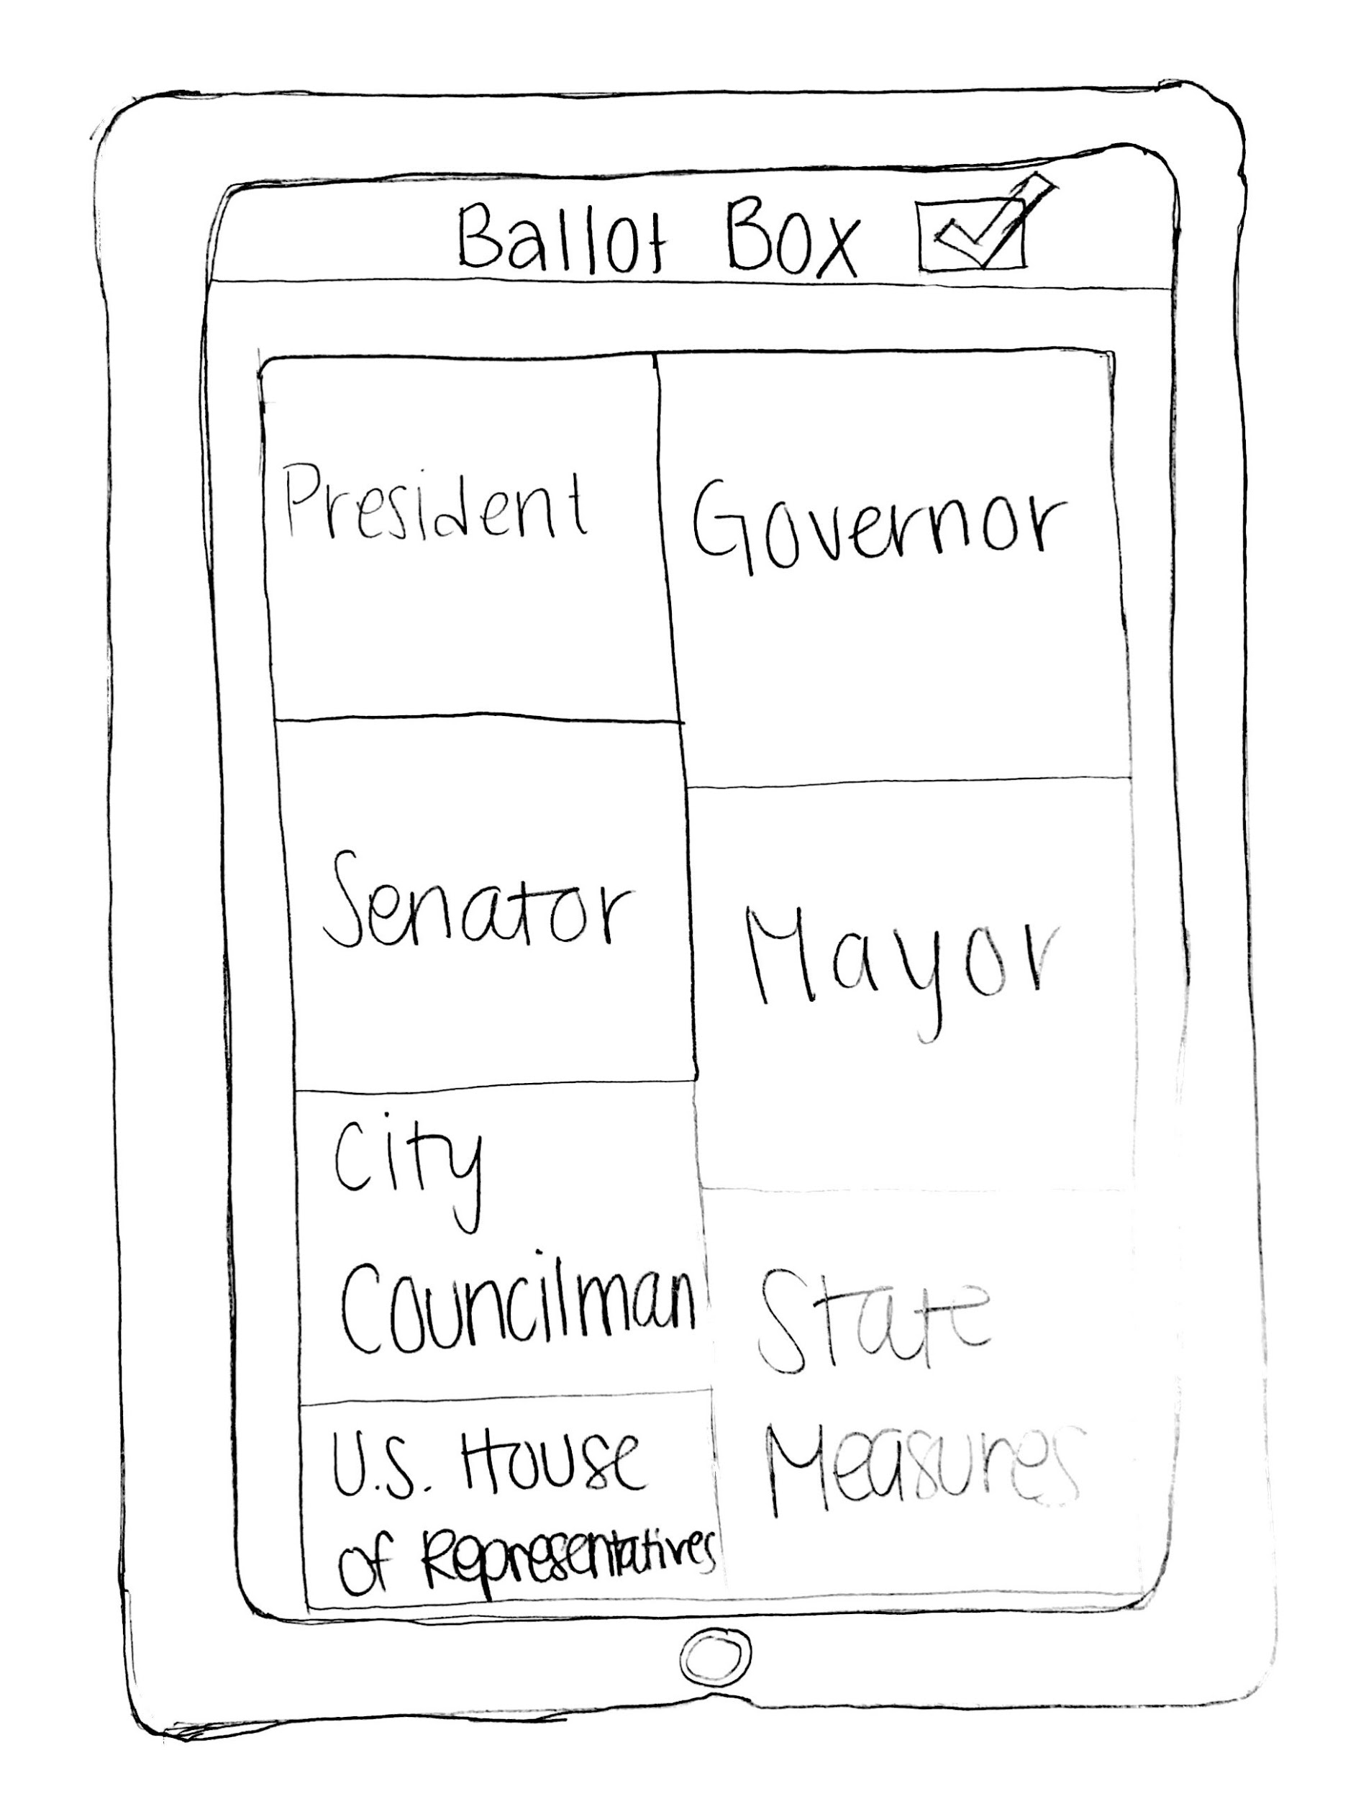
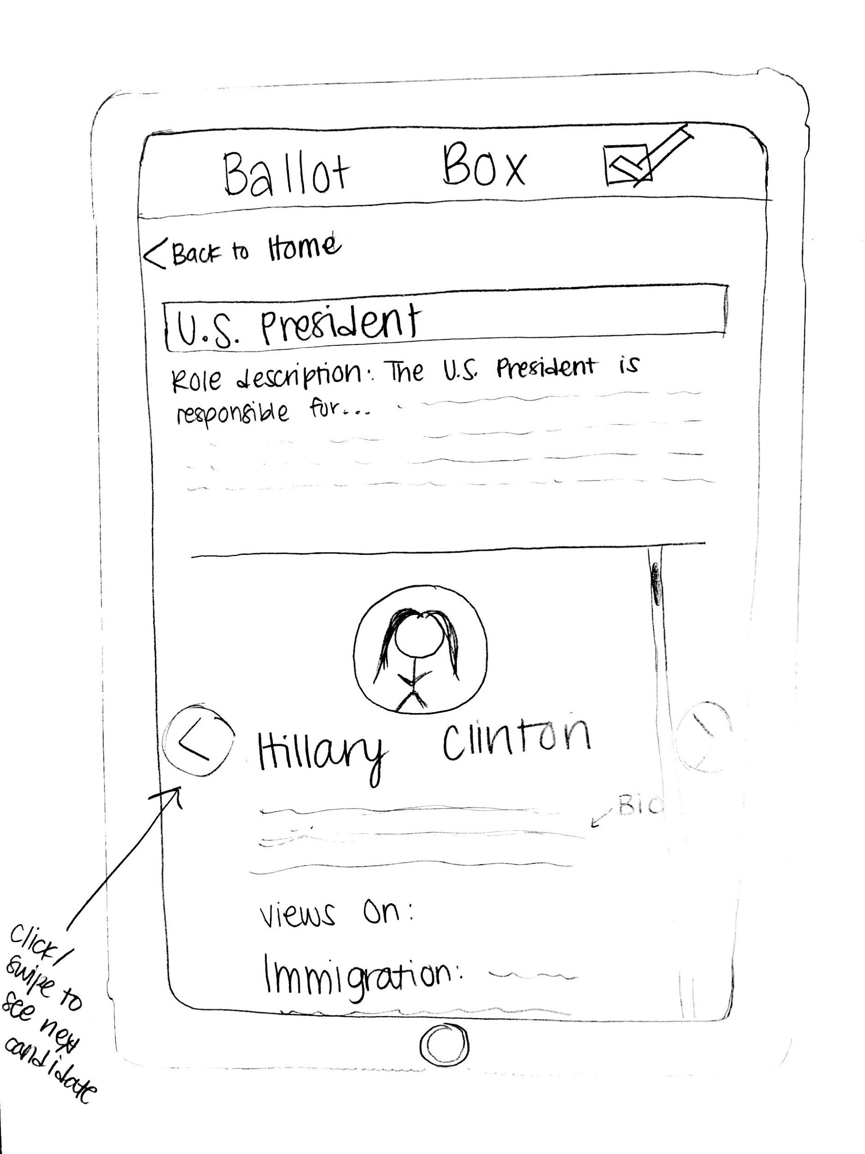
Results
CLICK
“I liked how intuitive
the categories are to click”
-participant 2

Slide 23
Results
BallotBox
BallotBox
“I wish there was a homepage explaining a little about the app”
-participant 2
Explore your ballot and the measures on it.

Slide 24
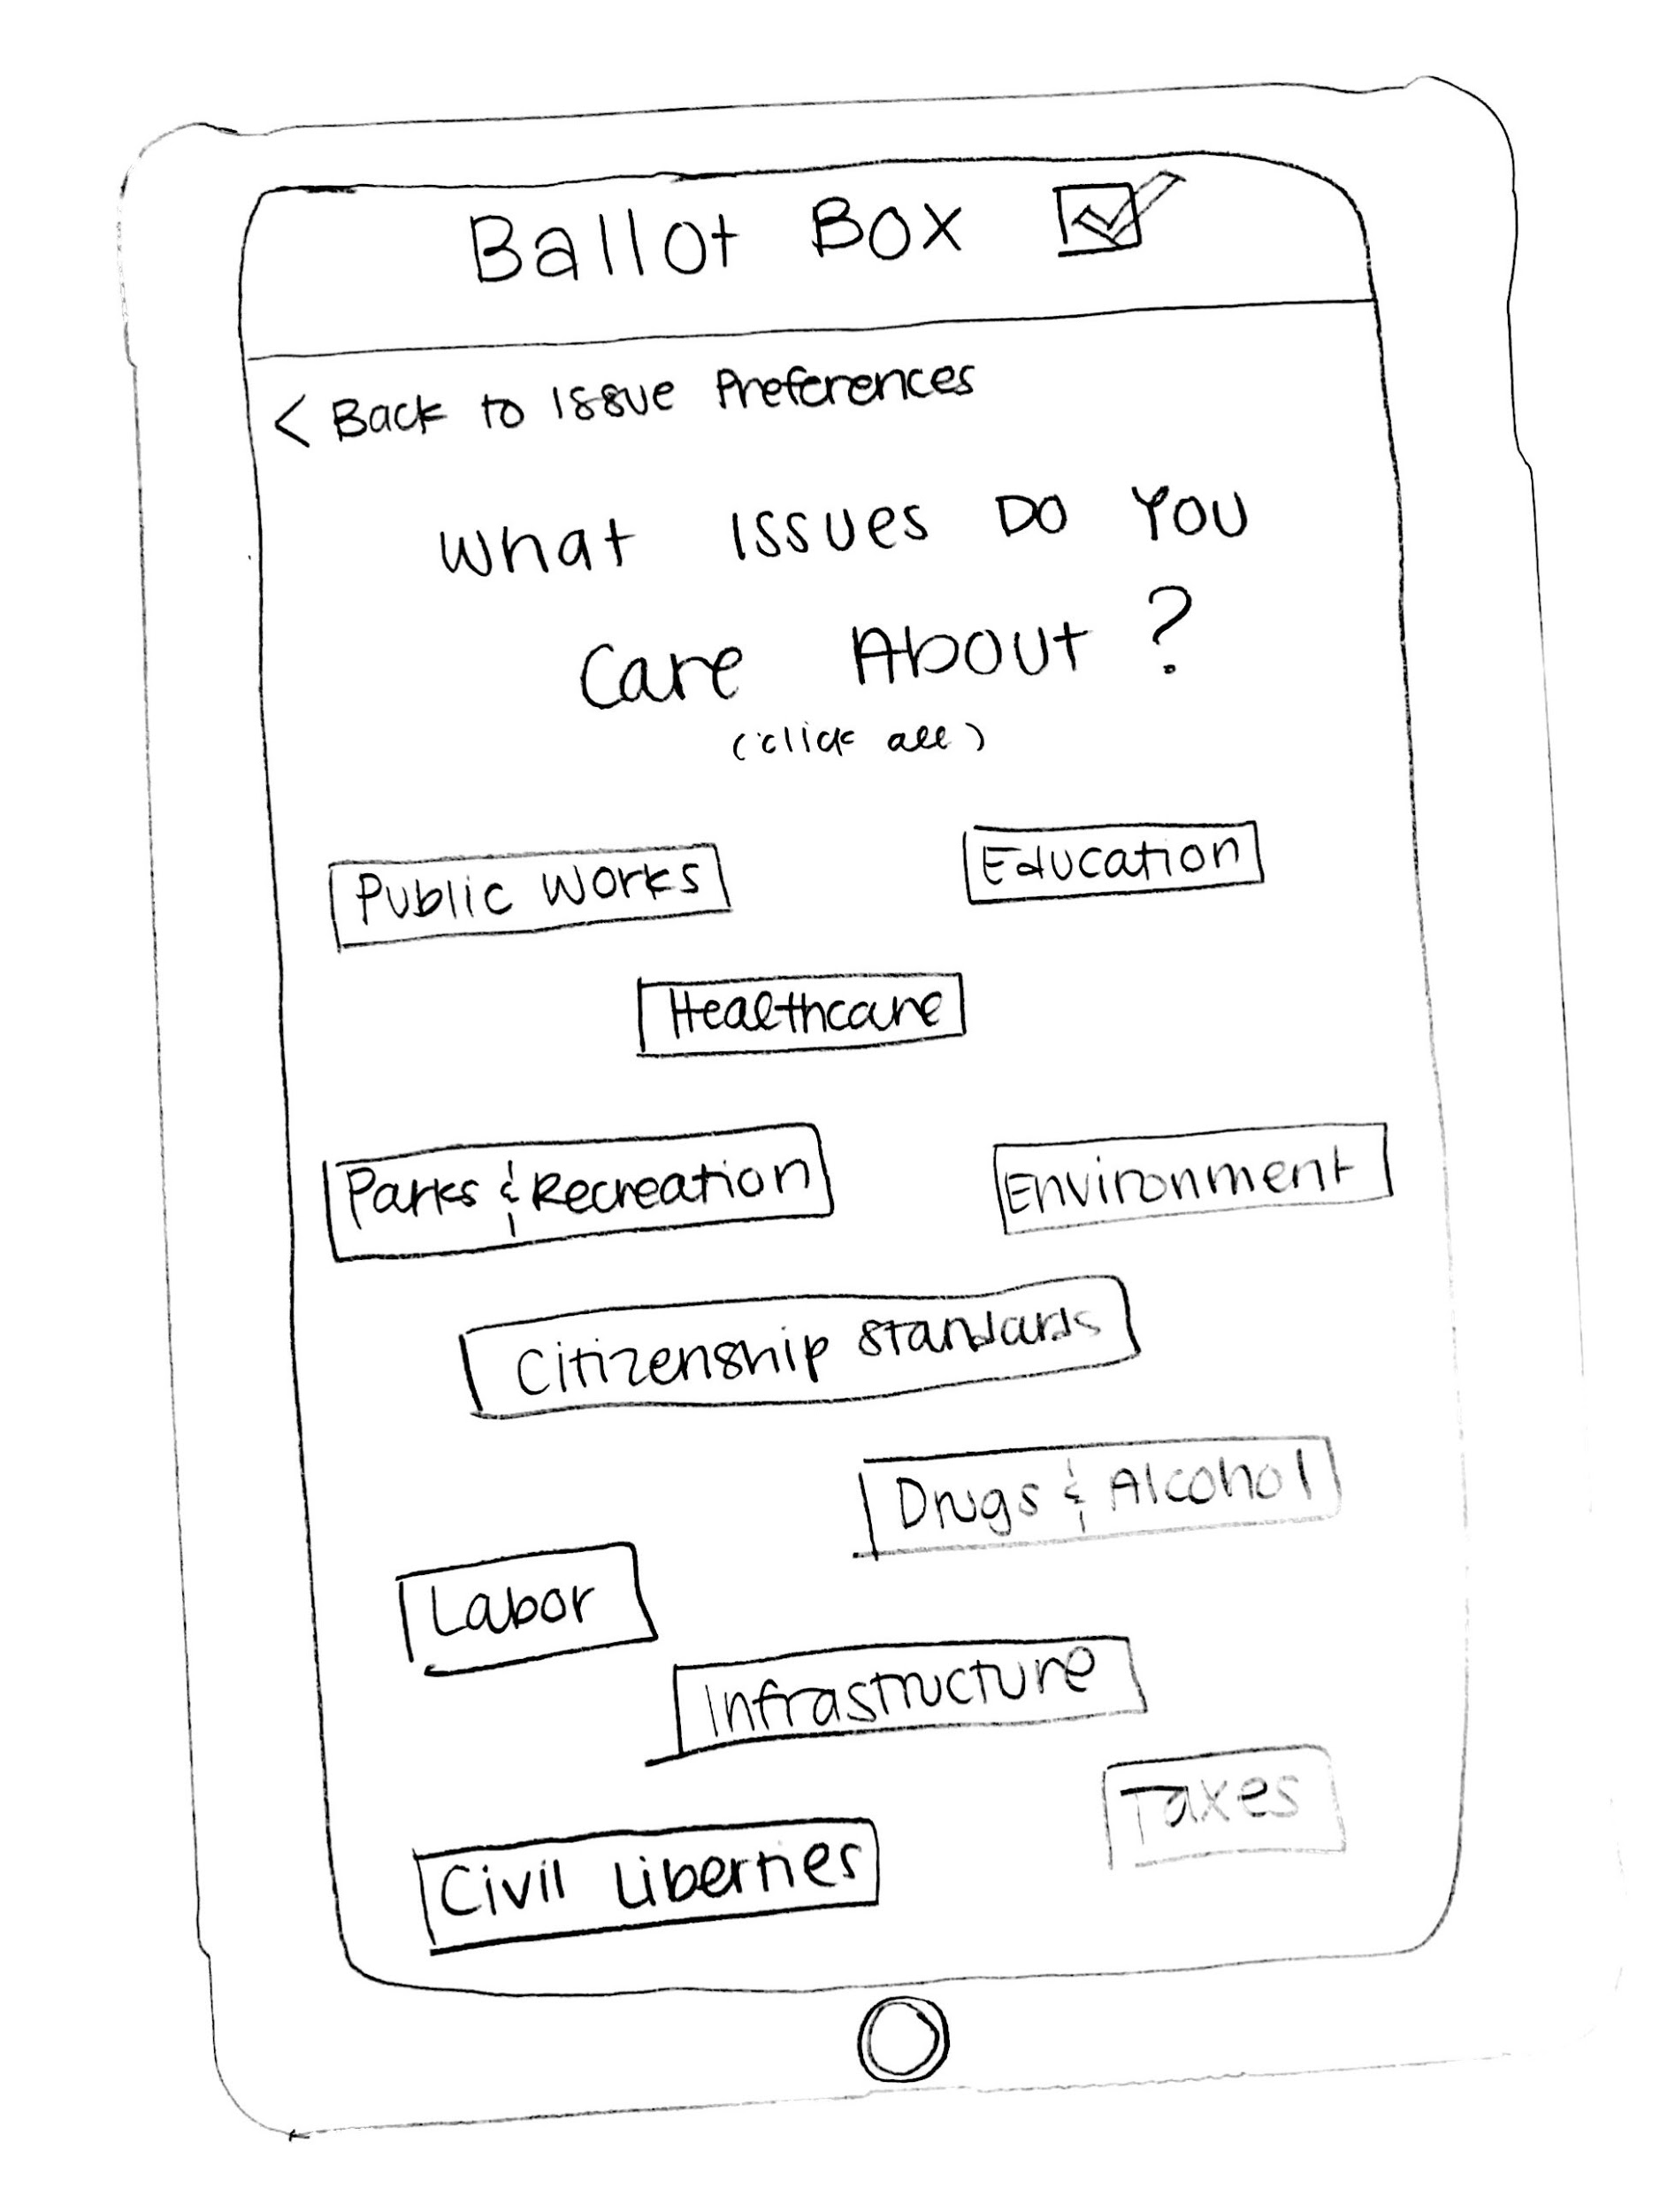
Results
Couldn’t find continue button
“Can I click more than one at a time?”
continue

Slide 25
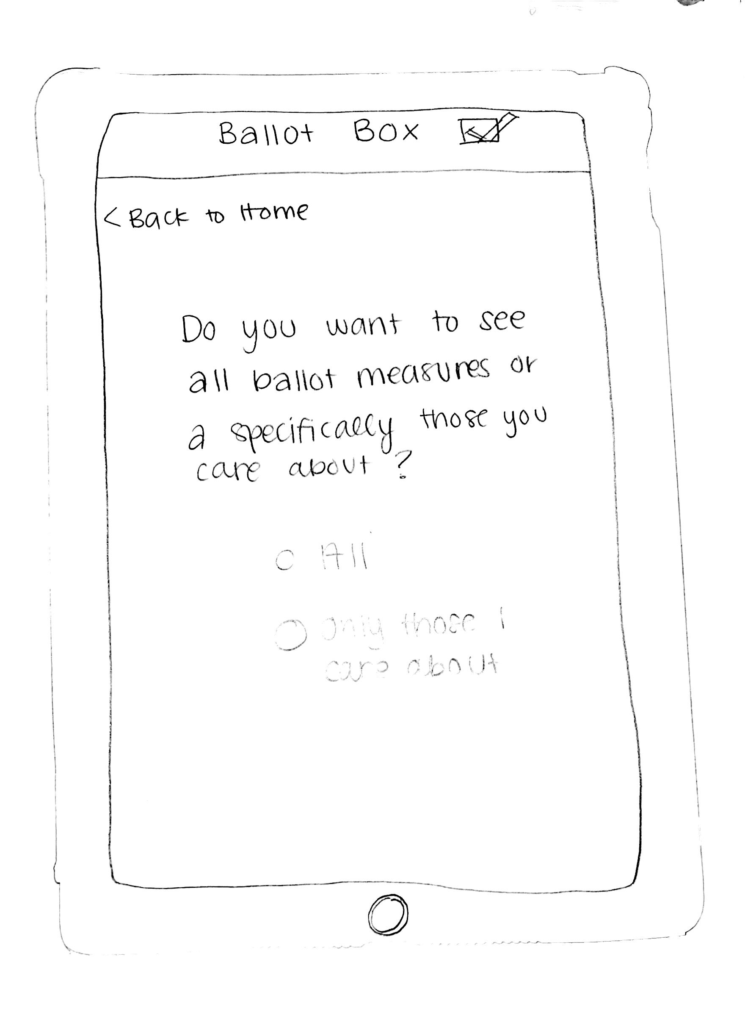
Results
“What if there was a quiz after this screen that asked you for personal info and suggested measures based on it?”

Slide 26
Moving Forward, UI changes
GOOD
→ Very intuitive and straightforward
→ Has all information necessary to understand ballot
→ Not cluttered
BAD/MISSING
→ Missing some key transitions
→ No clear homepage
→ More features (quiz) that could be added
CHANGES
→ Make sure we are considering all types of transitions and finger gestures.
→Tradeoffs of adding more features
→ Focus on
responsiveness of app

Slide 27
Thanks!
Any questions ?

Slide 28
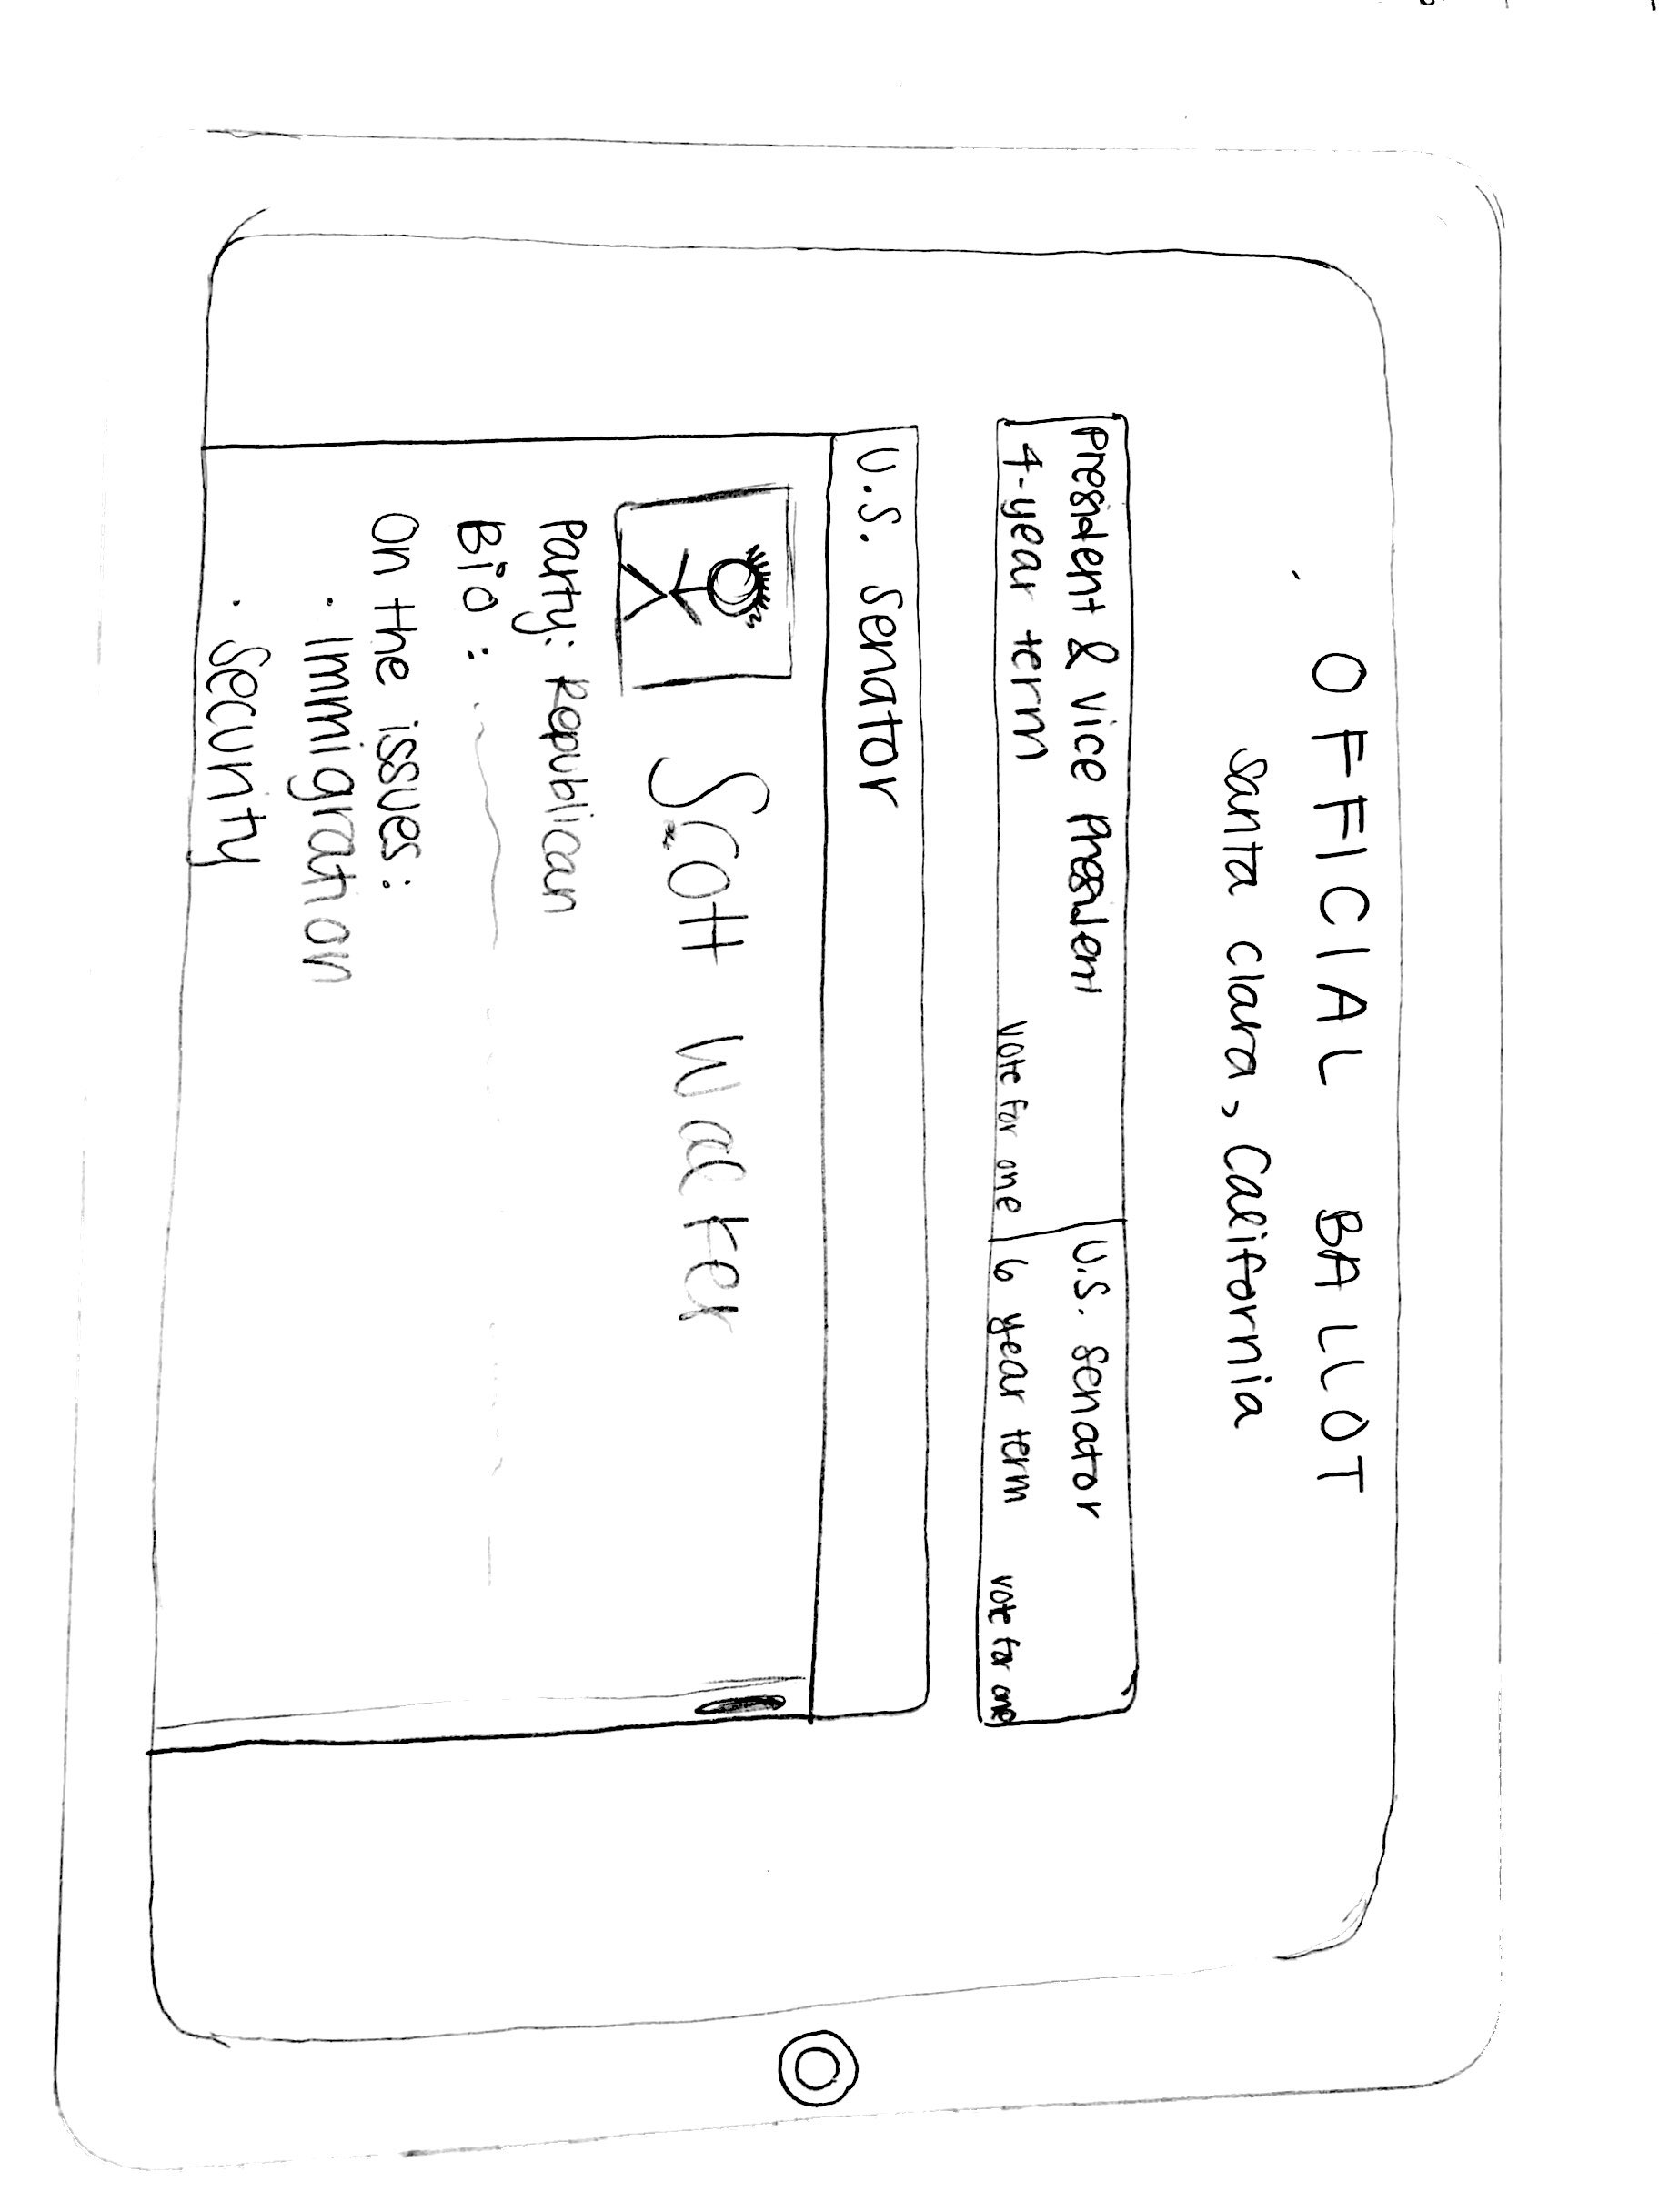
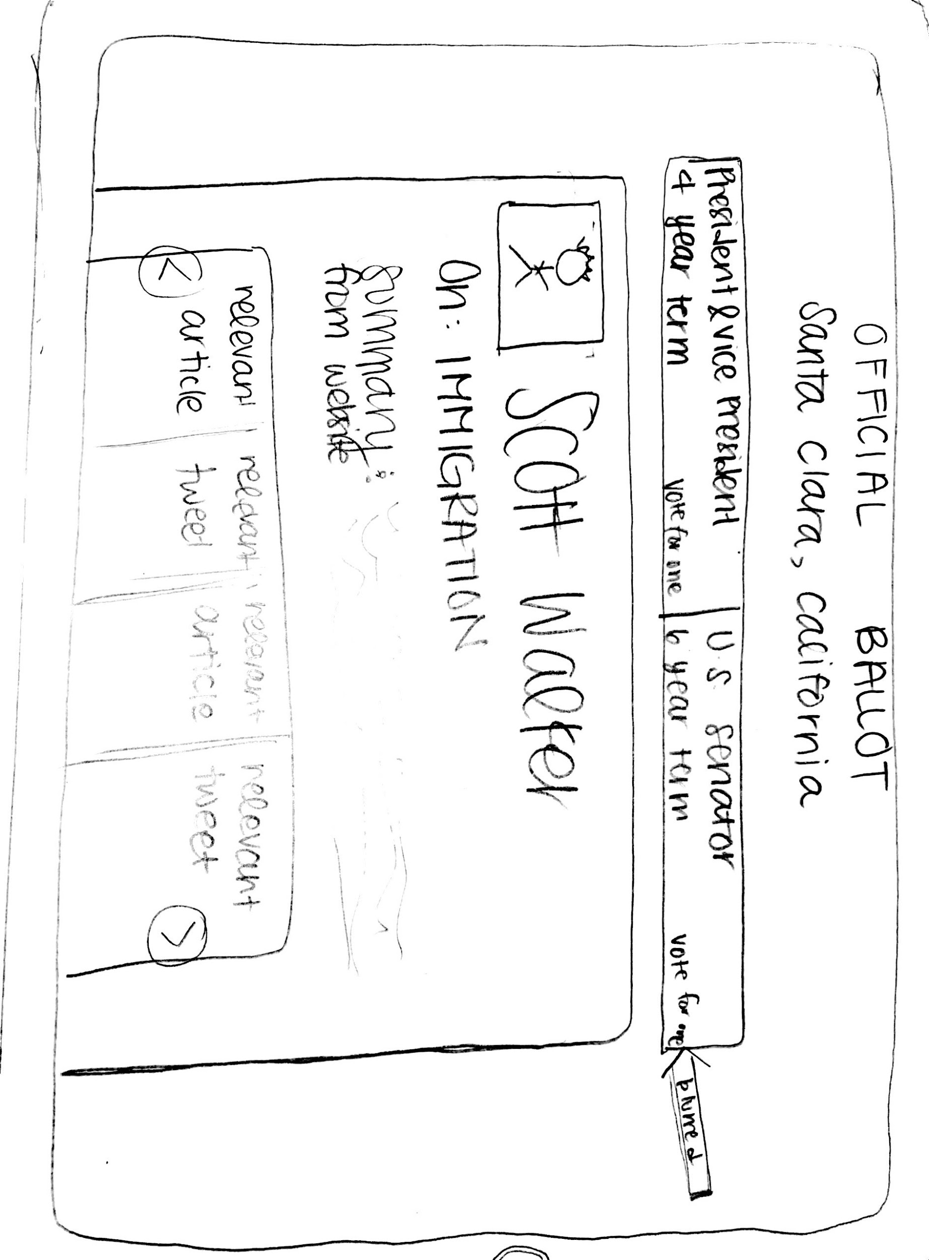
Sketches - Landscape

Slide 29
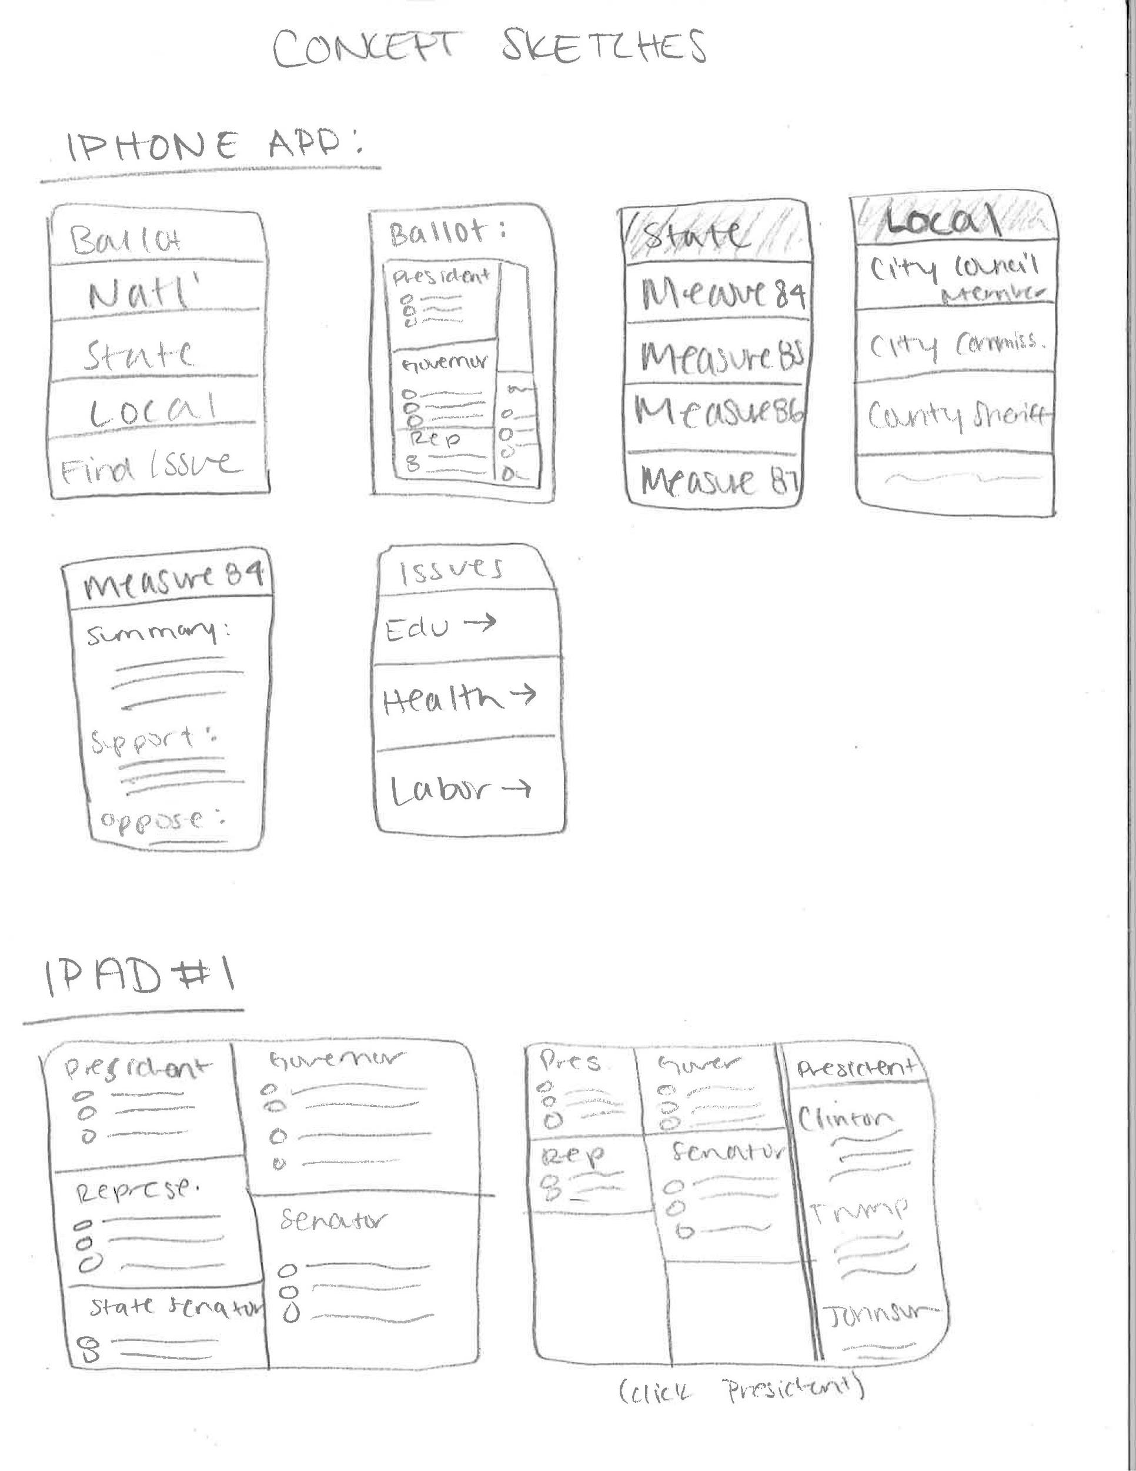
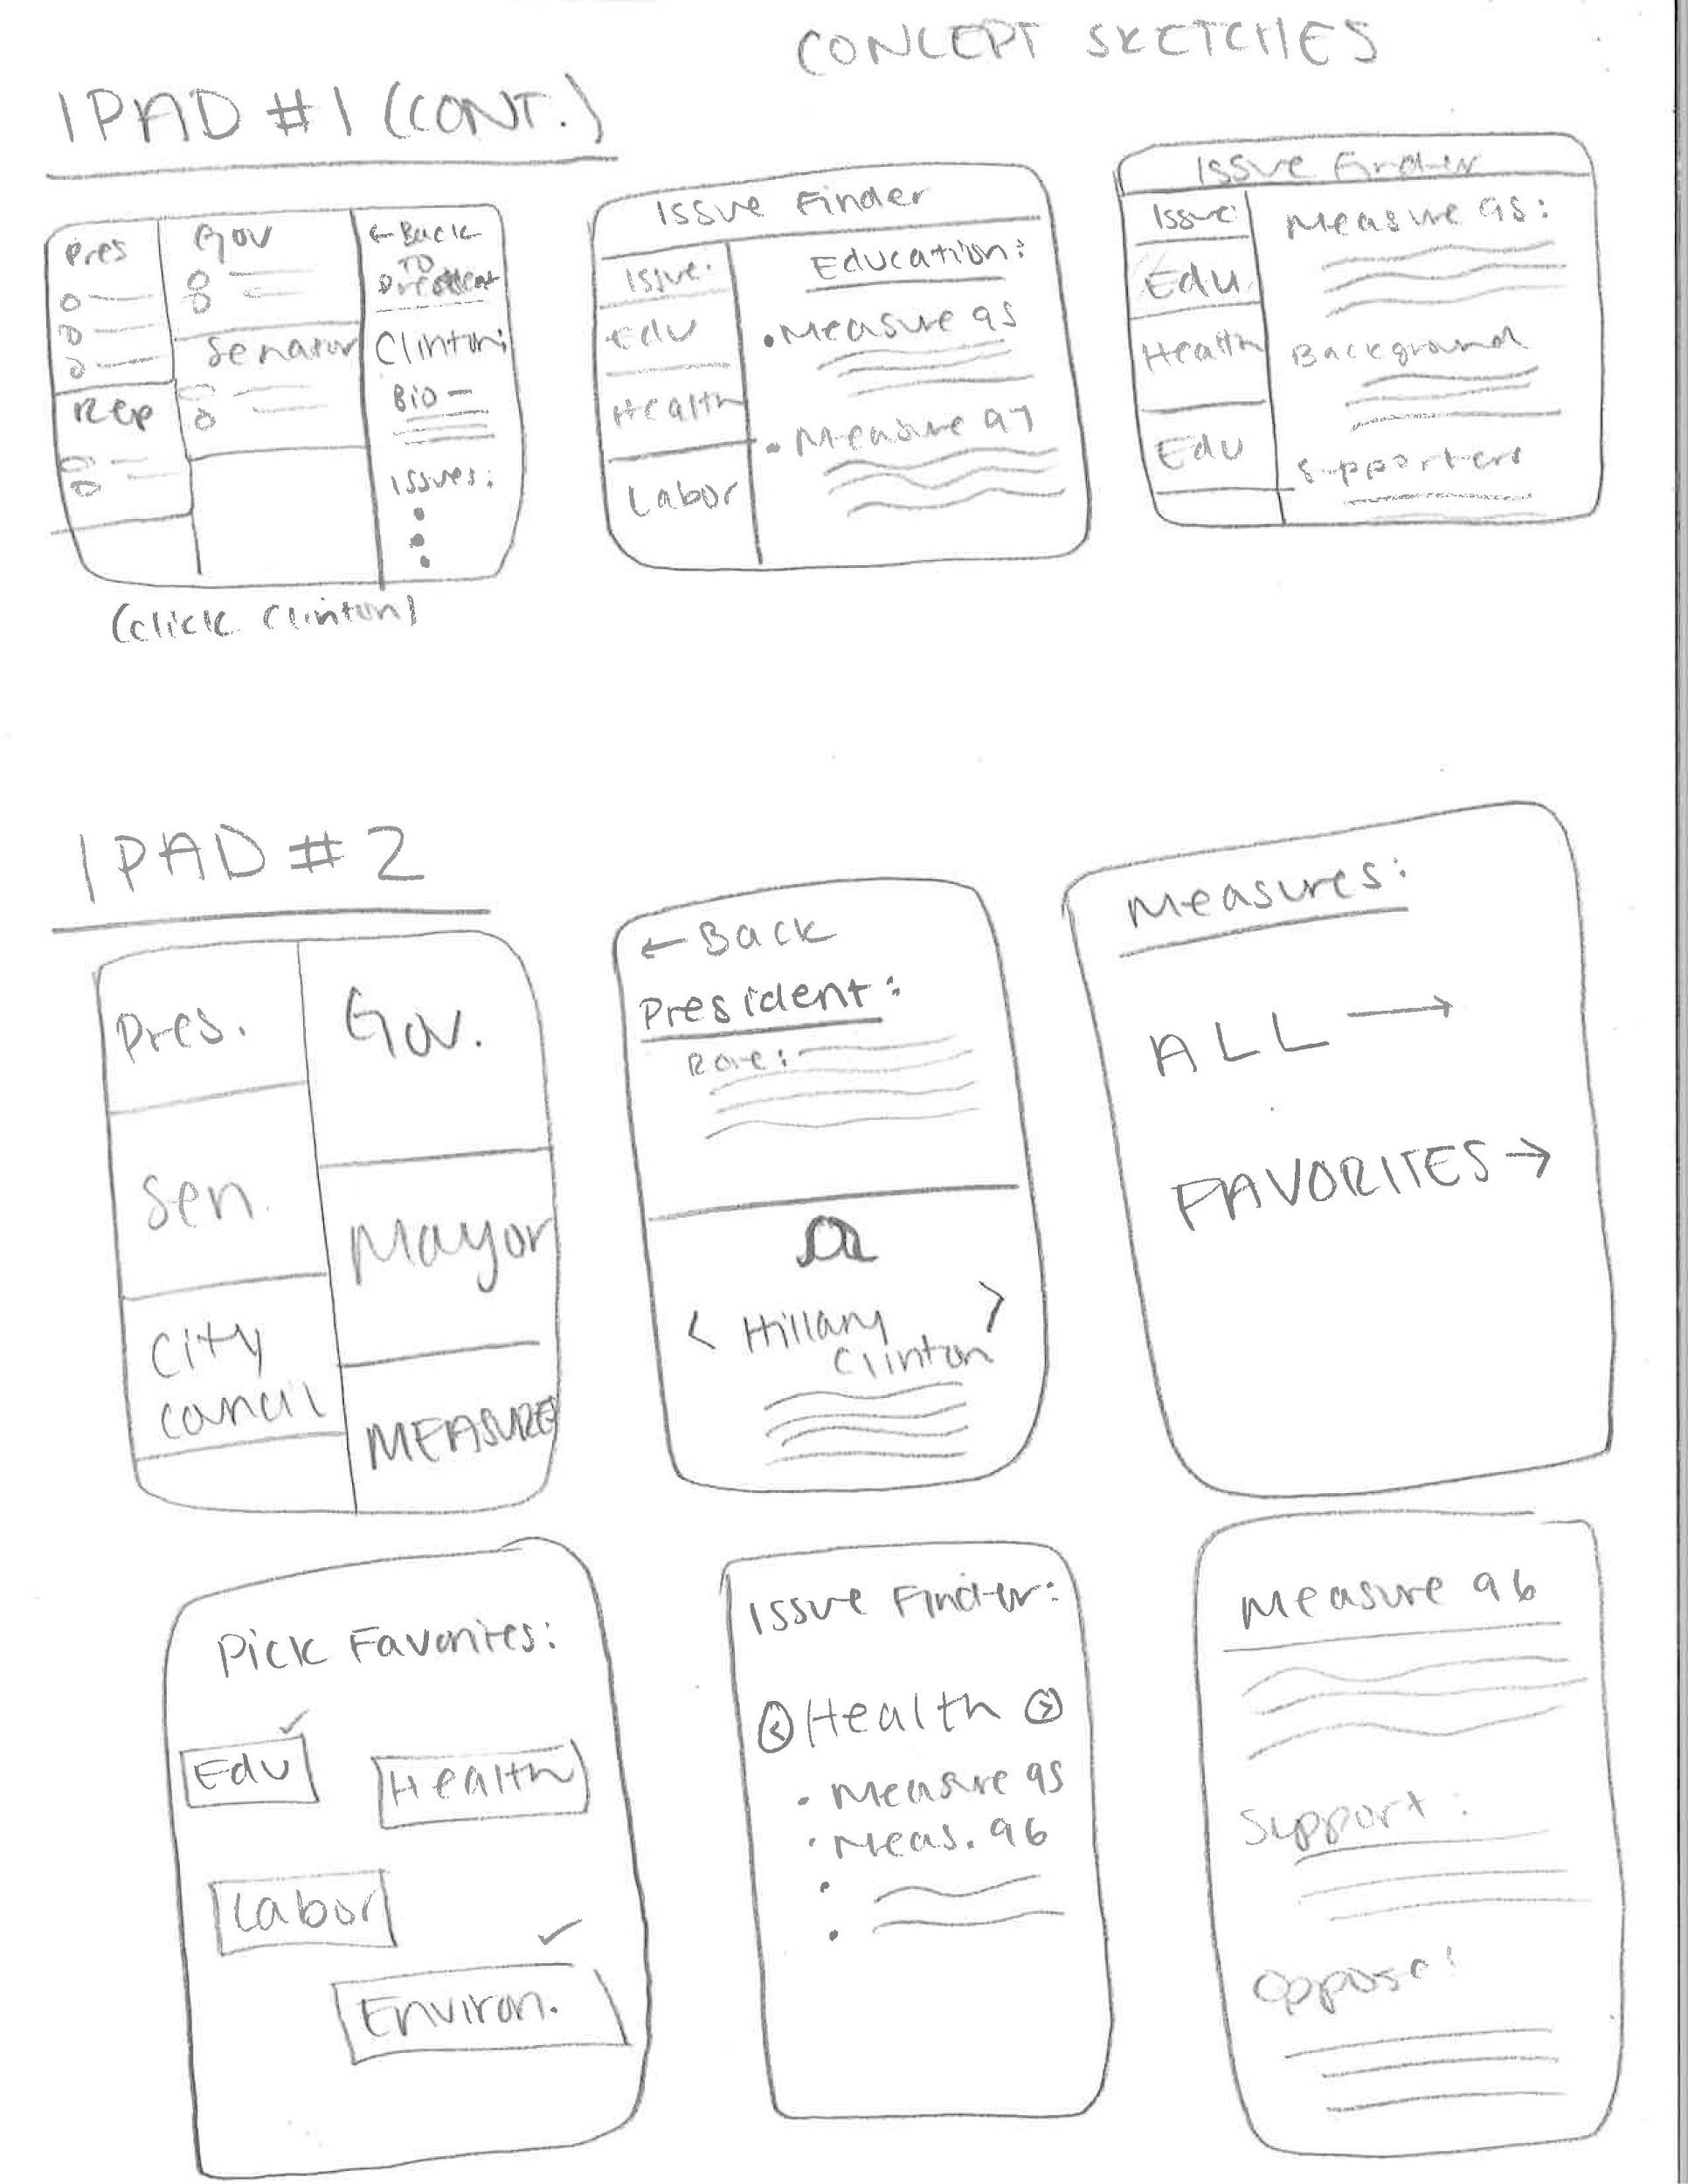
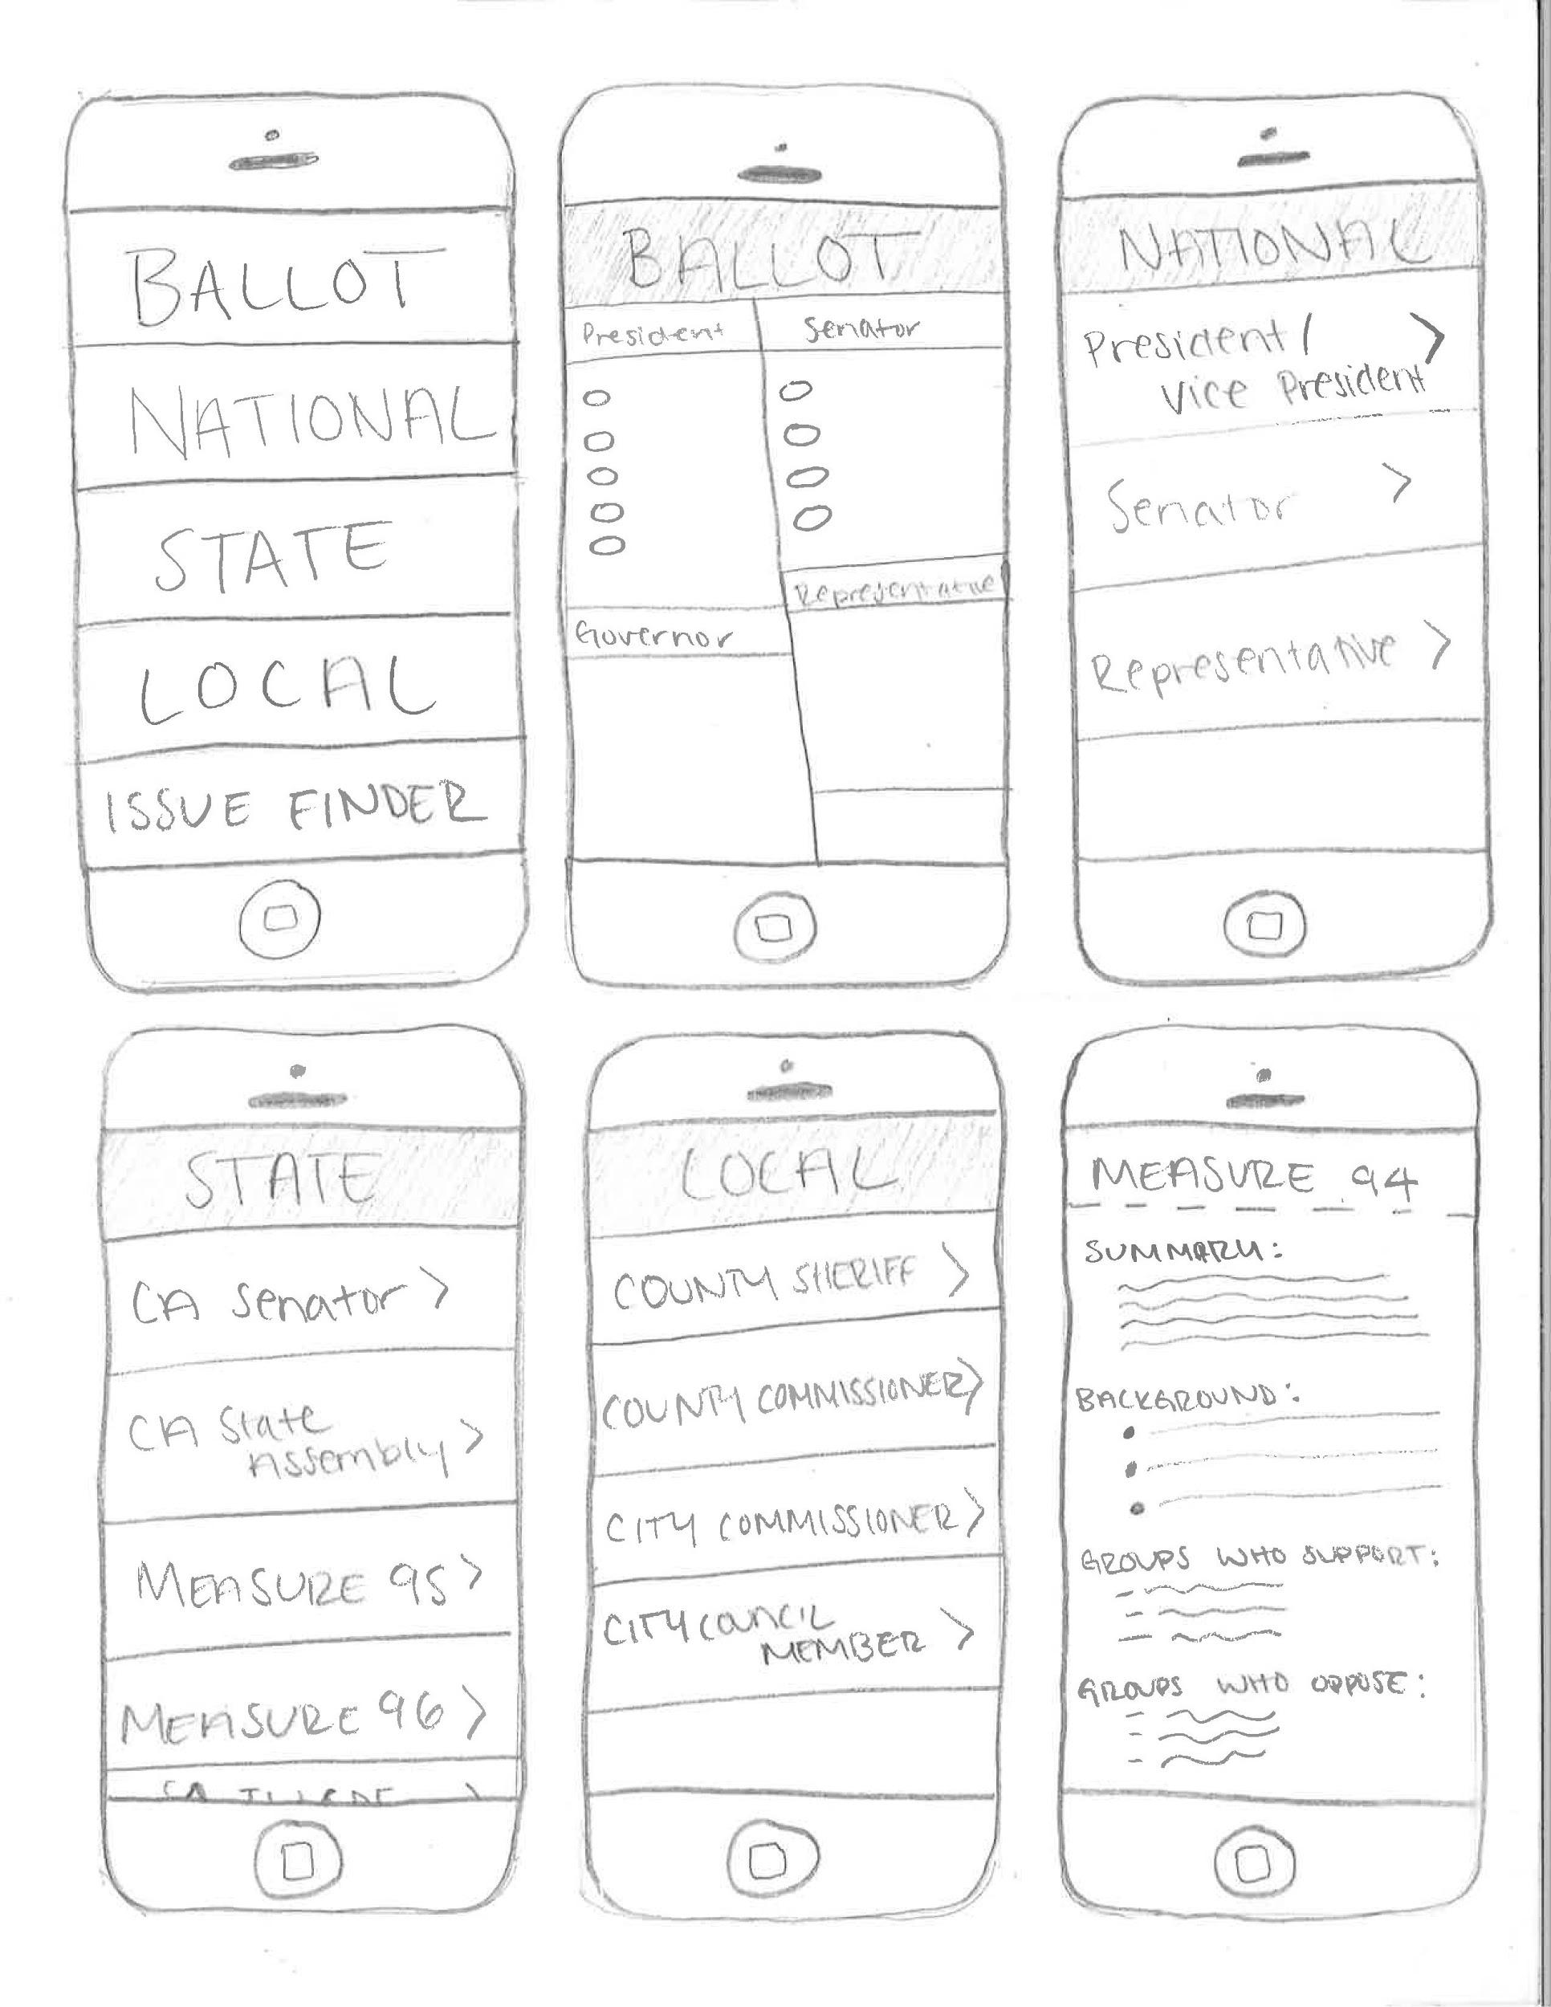
Sketches - Concept

